Slide 1
Short-sighted evolution of Influenza cellular receptor binding avidity
Authours:
Hsiang-Yu Yuan
James Hay
Christophe Fraser
Katia Koelle

Slide 2
figure1: The binding avidity changes of single amino acid mutations by net charge
Notes:
E:\Documents\Github\BindingAnal\validate_netcharge\plot_bindingchanges.R

Slide 3
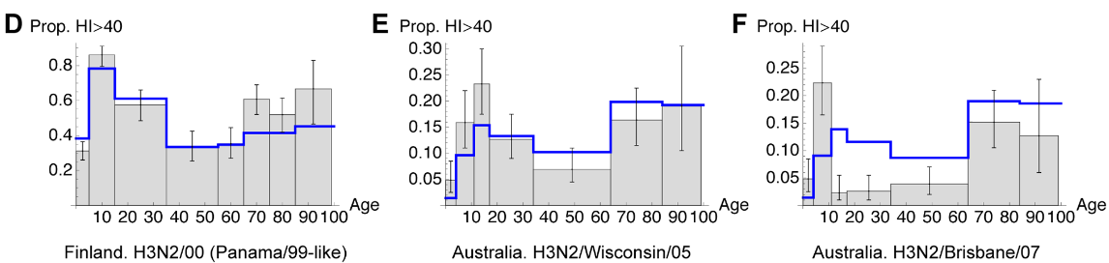
figure2: Net charge distribution by age group.
AJ Kucharski ‎2012 Plos CompBio
Notes:
E:\Documents\Github\BindingAnal\validate_netcharge\netcharge_age19.R

Slide 4
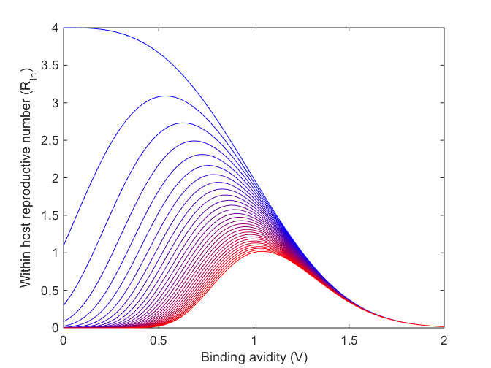
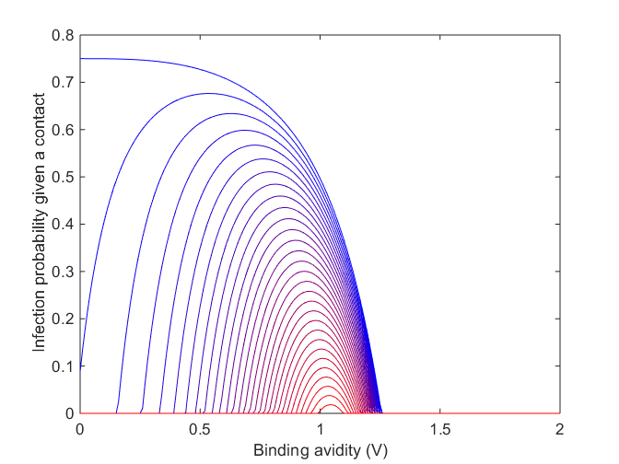
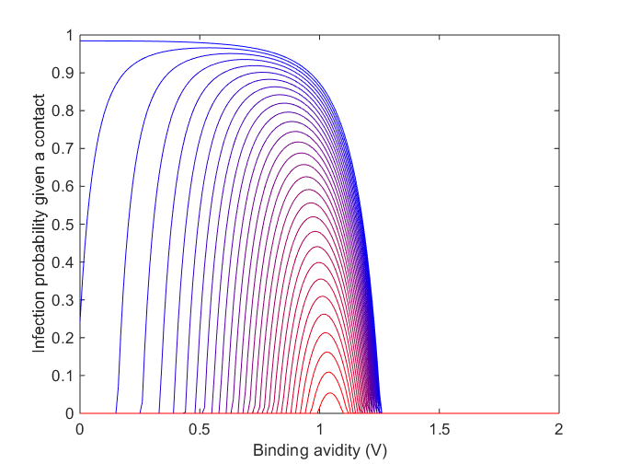
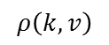
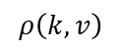
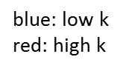
figure3: Within host reproductive number and the probability of infection.
$$ρ\left(k,v\right)$$
$$ρ\left(k,v\right)$$
blue: low k
red: high k
Notes:
(C) is the alternative fitness profile (without differential selection).

Slide 5
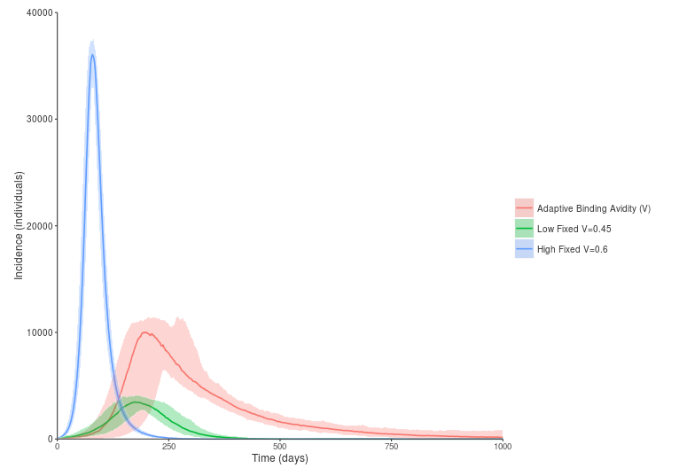
figure4: Simulated epidemic with and without within-host binding avidity adaptation
epidemic dynamics
immunological dynamics
Notes:
The figure is produced from IBM (The script James wrote)
workdir E:\Documents\Github\BindingAnal\fitness\tradeoff\Mtradeoff\dat\lowV0
workdir E:\Documents\Github\BindingAnal\fitness\tradeoff\Mtradeoff\dat\highV0
Parameter setting:
Low fixed V=0.45
Hight Fixed V=0.6
Adaptive binding V0=0.45
D = 200day

Slide 6
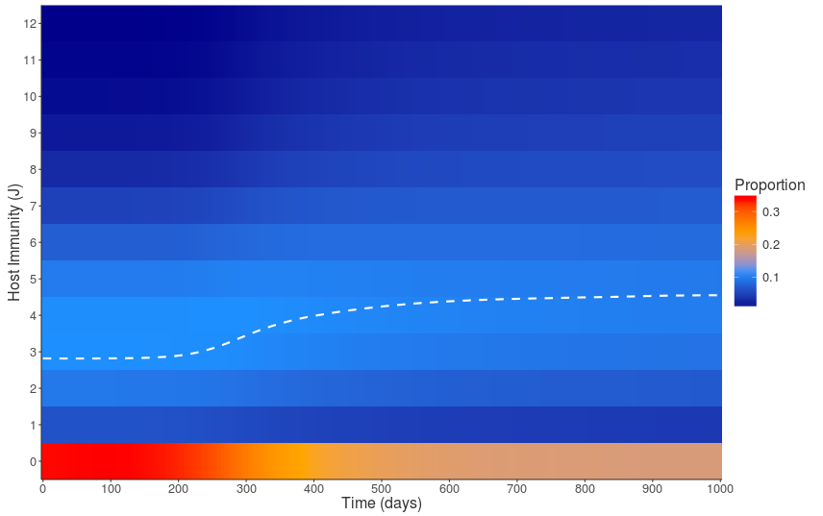
figure5: Distribution of population immunity during the epidemic with binding avidity adaptation

Slide 7
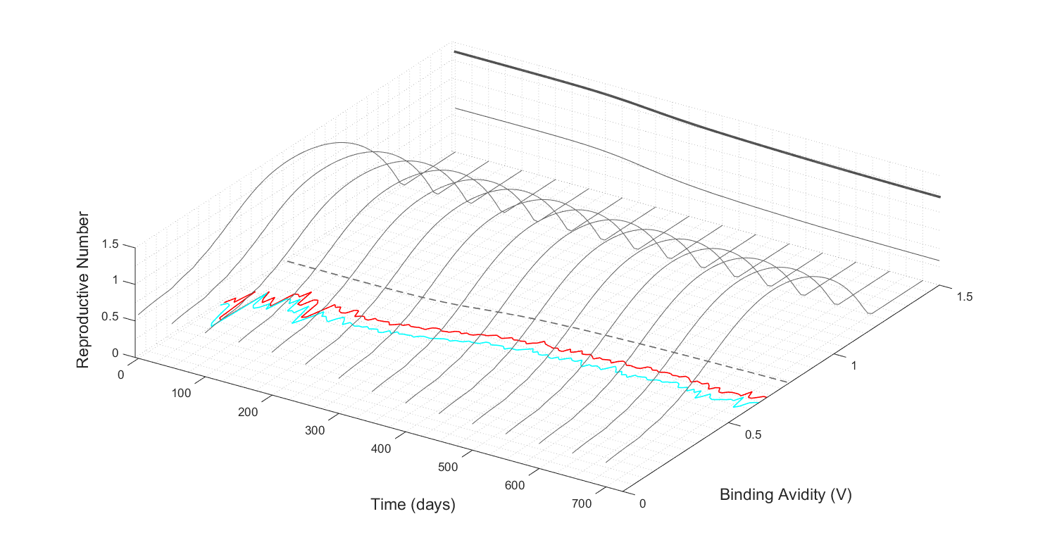
figure6: The effective reproductive number by time and binding avidity.
Notes:
Dashed: Optimum binding avidity
Red: Initial binding avidity
Cyan: Final binding avidity
workdir E:\Documents\Github\BindingAnal\fitness\tradeoff\Mtradeoff
example:
infileV = 'dat/lowV0/voutput1_low_adaptive.csv';
infile = 'dat/lowV0/hostKs_low_adaptive.csv'
plotPopRfromSkwithBinding(infile, infileV)
E:\Documents\Github\BindingAnal\fitness\tradeoff\Mtradeoff\dat\lowV0\virusbinding.mat, which contains:
Vfinal, Vini and Vopt. But I am not sure what this data is for?

Slide 8
figure7: Within-host and between-host relative fitness by binding avidity and antigenic changes
Notes:
E:\Documents\Github\BindingAnal\fitness\tradeoff\Mtradeoff\figs\fitness

Slide 9
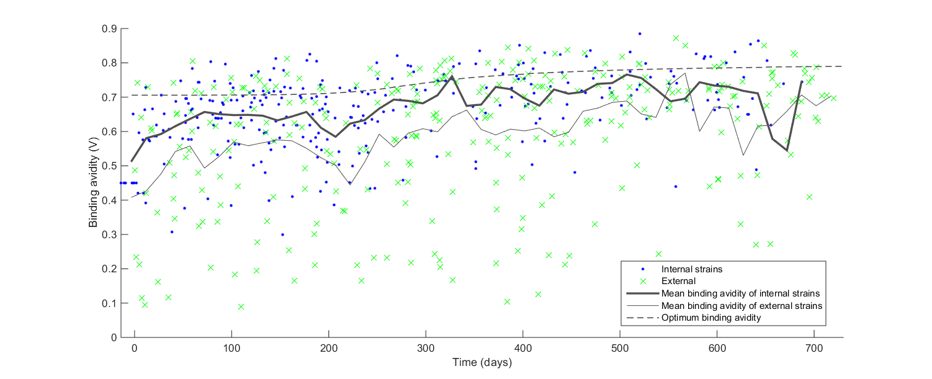
figure8: The deleterious effect of within-host binding avidity adaptation on viral phylogeny
Notes:
Change it to simulated binding avidity.
workdir: E:\Documents\Github\BindingAnal\ParseTree\mat\Mparsetree
plotNetchargeByTimeSim(infile, infileB)
infile = ‘dat/lowV0/voutput1_low_adaptive_tree_300_simple.mat’
infileB = ‘dat/lowV0/virusbinding_low_adaptive.mat’

Slide 10
Figure9: Phylogenetic analysis of cellular receptor binding avidity
For all internal nodes, only 7.7% of the strains showed netcharge change
whereas in external tips, which were destined to die out soon, a higher proportion of the strains (11.8%) changed the netcharge
Notes:
Studies showed that higher ratios of non-synonymous-to-synonymous substitutions on external tree branches relative to those found internally (http://dx.doi.org/10.1093/molbev/msm001).
workdir: E:\Documents\Github\BindingAnal\ParseTree\mat\Mparsetree
1. To compare the variance between internal and external nodes
[netcharge ] = calNetCharge( )
internal vs external
proportion of netcharge change (7.8% vs 12.1%)
the variance (1.13 vs 1.18)
netcharge prevalence(>18) (20.0% vs 18.7%)
2. To find out the
which code produce this hm_h3n2_ny_charge_1993_2006.mat and newick_elements.mat?
hm_h3n2_ny_charge_1993_2006.mat is not consistent to my tree file

Slide 11
FigureS1. The relative binding avidity by absolute net charge
Notes:
E:\Documents\Github\BindingAnal\validate_netcharge\plot_bindingchanges_abs_reg.R

Slide 12
FigureS2: Changes of within- and between-host relative fitness by time during the epidemics
Notes:
To be changed: Make it as 3d surface
workdir: E:\Documents\Github\BindingAnal\fitness\tradeoff\Mtradeoff
infile = 'dat/lowV0/hostKs_low_adaptive.csv‘
infileV = ??
plotMutSelBalance(infile)

Slide 13
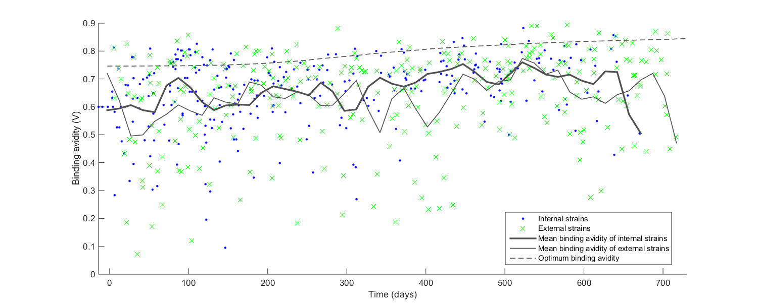
FigureS3: The neutral effect of within-host binding avidity adaptation on viral phylogeny
Notes:
voutput1_low_adaptive_tree_300_simple.png
workdir: E:\Documents\Github\BindingAnal\ParseTree\mat\Mparsetree
plotNetchargeByTimeSim(infile, infileB)
infile = ‘dat/highVirus/voutput1_highv_tree_300_simple.mat’
infileB = ‘dat/highVirus/virusbinding.mat’

Slide 14

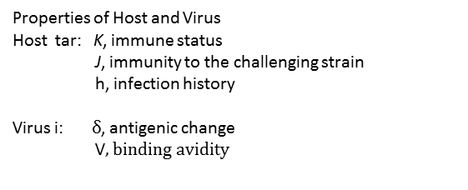
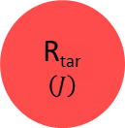
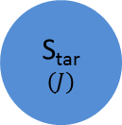
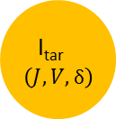
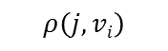

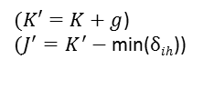
FigureS4: Schema of the disease transmission in the individual-based model
Properties of Host and Virus
Host tar: K, immune status
J, immunity to the challenging strain
h, infection history
Virus i: $δ$, antigenic change
V$, binding avidity$
I_{src}$\left(J,V,δ\right)$
$$ρ\left(j,vi\right)$$
S_{tar}
$$\left(J\right)$$
I_{tar}$\left(J,V,δ\right)$
R_{tar}
$$\left(J\right)$$
γ
$$w$$
$(K′=K+g$)
$(J^{′}=K^{′}−$ min($δih$))

Slide 15
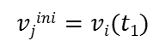
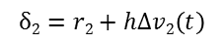
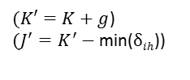
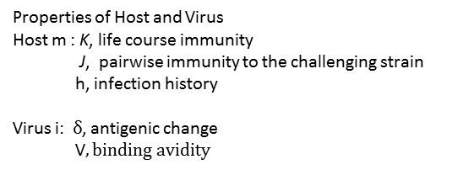
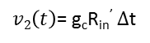
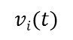
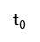
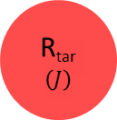
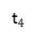
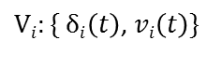
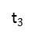
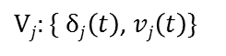

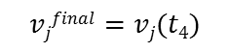
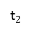
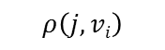
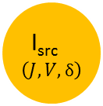
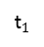
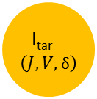
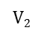
FigureS4: Schema of the disease transmission in the individual-based model
Properties of Host and Virus
Host m : K, life course immunity
J, pairwise immunity to the challenging strain
h, infection history
Virus i: $δ$, antigenic change
V$, binding avidity$
I_{src}$\left(J,V,δ\right)$
$$ρ\left(j,vi\right)$$
S_{tar}
$$\left(J\right)$$
I_{tar}$\left(J,V,δ\right)$
R_{tar}
$$\left(J\right)$$
γ
$$w$$
$(K′=K+g$)
$(J^{′}=K^{′}−$ min($δih$))
$Vj:\{ δj\left(t\right)$, $vj\left(t\right)\}$
$$vjfinal=vj(t4)$$
$$vjini=vi(t1)$$
$Vi:\{ δi\left(t\right)$, $vi\left(t\right)\}$
$$vi(t)$$
t$0$
t$1$
t$2$
t$3$
t$4$
$$V2$$
$$δ2=r2+hΔv2\left(t\right)$$
$v2\left(t\right)$= g_{c}R_{in}’ $Δ$t

Slide 16
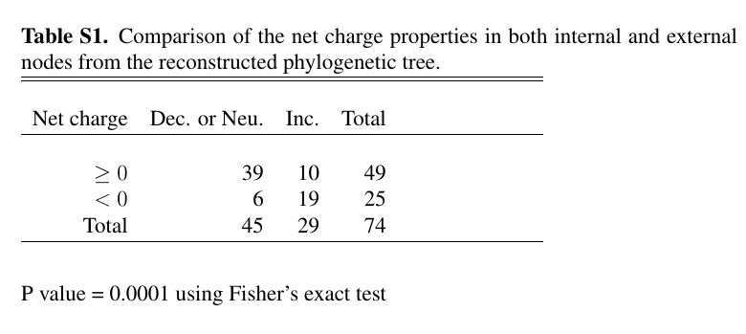

Slide 17
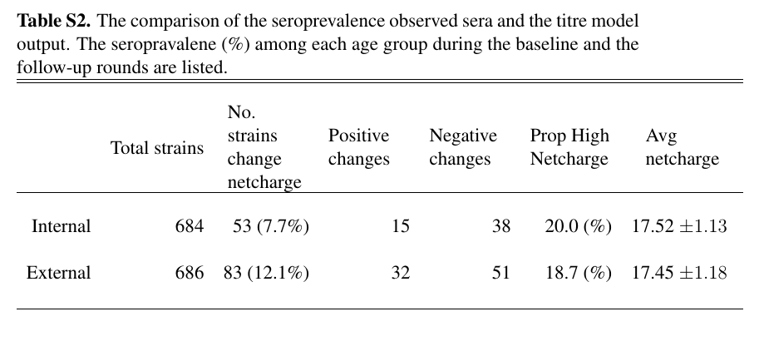

Slide 18
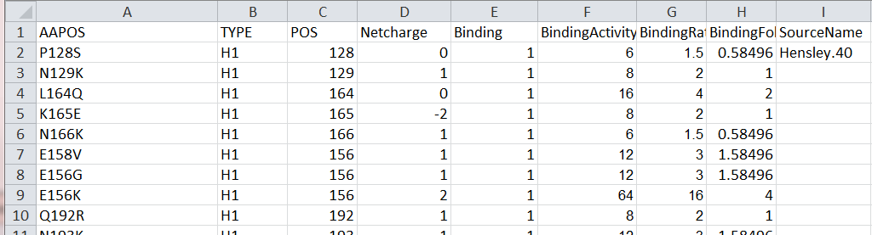
TableS3. validate_netcharge.csv

